Slide 1
DMP Online
Kerry Miller
Digital Curation Centre
University of Edinburgh
Kerry.miller@ed.ac.uk
Funded by:
This work is licensed under the Creative Commons Attribution-NonCommercial-ShareAlike 2.5 UK: Scotland License. To view a copy of this license, (a) visit http://creativecommons.org/licenses/by-nc-sa/2.5/scotland/ ; or, (b) send a letter to Creative Commons, 543 Howard Street, 5th Floor, San Francisco, California, 94105, USA.

Slide 2
Running Order
I: DMP Online v3.0
How it works
Working with institutions and funders
Supporting researchers
Usage
II: Future plans
The Checklist
The Online tool
III: Contact details and resources

Slide 3
Running Order
I: DMP Online v3.0
How it works
Working with institutions and funders
Supporting researchers
Usage
II: Future plans
The Checklist
The Online tool
III: Contact details and resources

Slide 4
I: DMP Online v3.0 – How it Works
DMP Online is a web-based tool that enables users to...
Create, store and update multiple versions of DMPs at the application and in-project stages
Meet funders’specific data-related requirements
Get funder- and institution-specific guidance on best practice and helpful contacts
Customise and export DMPs in a variety of formats
Overlay multiple templates
Share plans with other researchers or support staff
Produce customised institutional versions of the tool
Notes:
I can do a quick demo after the exercise if we have some time

Slide 5
I: DMP Online v3.0 – How it Works
Overview
User logs-in and starts a new DMP by filling in some basic details
Then they choose the template(s) they need from the ones available
Each template contains a sub-set of the checklist questions which have been mapped to the requirements of the funder, institution, or discipline they have selected
Each template also contains detailed guidance and links to further information to help the researcher complete the DMP
The researcher who begins the DMP can share it with their collaborators or with support staff so that they can work together to complete the plan.
Once complete the plan can be exported in a variety of different formats and submitted alongside a grant application.
Notes:
I can do a quick demo after the exercise if we have some time

Slide 6
I: DMP Online v3.0 – How it Works

Slide 7
I: DMP Online v3.0 – How it Works

Slide 8
I: DMP Online v3.0 – How it Works

Slide 9
I: DMP Online v3.0 – How it Works

Slide 10
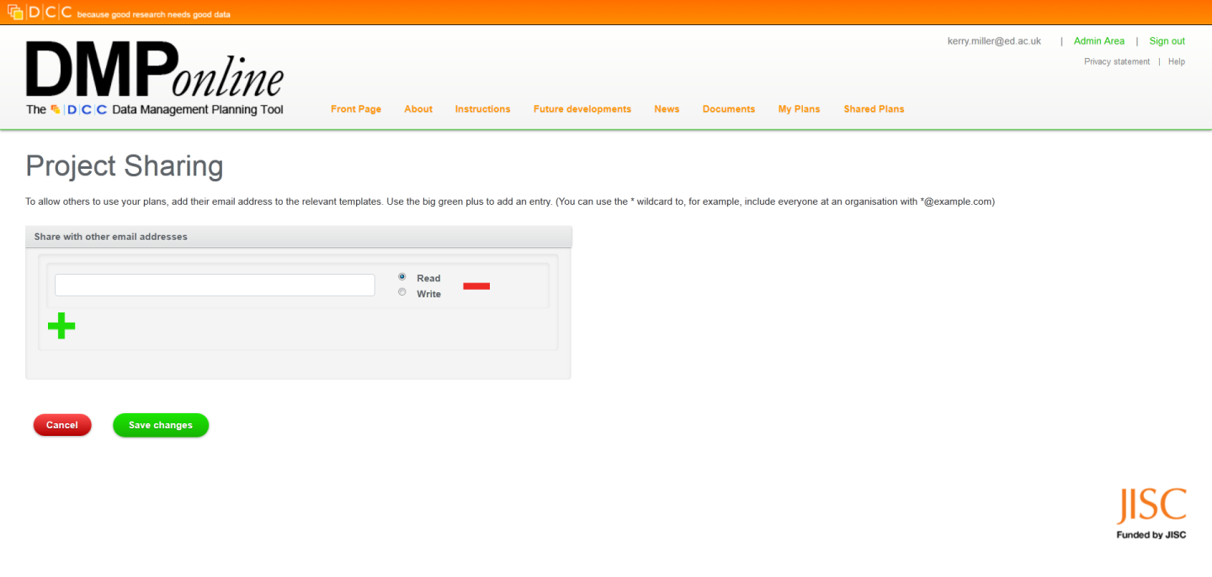
I: DMP Online v3.0 – How it Works

Slide 11
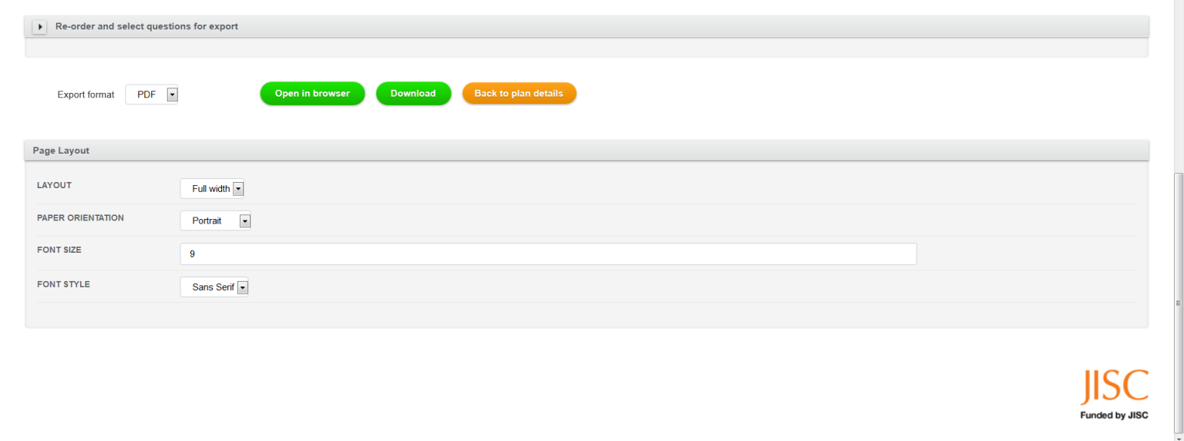
I: DMP Online v3.0 – How it Works

Slide 12
I: DMP Online v3.0 – How it Works

Slide 13
I: DMP Online v3.0 – Working with institutions and funders
A central service that asks all researchers the questions they want answered,
Ability to offer tailored guidance and links to other support,
Institutions can direct researchers to use the services they provide, or direct them to appropriate external services,

Slide 14
I: DMP Online v3.0 – Working with institutions and funders

Slide 15
I: DMP Online v3.0 – Working with institutions and funders

Slide 16
I: DMP Online v3.0 – Supporting Researchers
Breaks down complex funder requirements into simple questions
Provides detailed guidance and links to further support
Ensures they meet funder requirements when making grant applications
Provides a plan that they can develop and work to throughout the life of a project
Creates a record of the data created and where and how it will be stored long-term
Alerts them to potential pit-falls and problems they may need to address

Slide 17
Running Order
I: DMP Online v3.0
How it works
Working with institutions and funders
Supporting researchers
Usage
II: Future plans
The Checklist
The Online tool
III: Contact details and resources

Slide 18
II: Future Plans – The Checklist
The Checklist will be simplified
Number of questions reduced
Relationship with funder questions will change
Guidance will be reviewed to ensure it is fully up-to-date and comprehensive – but written in language researchers will recognise.

Slide 19
II: Future Plans – The Online Tool
Significant improvements to the:
User Interface
Registration process
Workflows
Wizards to guide users
Templates shortened and simplified to ask funder questions directly

Slide 20
II: Future Plans – The Online Tool
New Checklist used to link questions to guidance and support
Export formats improved
Status of plans recorded
Terms and Conditions will be updated to allow use of aggregated data – while maintaining the privacy of users

Slide 21
II: Future Plans – The Online Tool
DMP Online community of Users, Developers, Funders, and Institutions
Main changes in place by April 2013
Read Kevin Ashley’s blog post at http://www.dcc.ac.uk/news/future-plans-dmponline

Slide 22
III: Contact details and resources
All of our DMP-related resources available online at:
www.dcc.ac.uk/dmponline/
THANK YOU
Kerry.miller@ed.ac.uk

